Slide 1
文献分享
诸葛昌靖
(北京工业大学)
August 4, 2020

Slide 2
文章概况
目标
方法
Accurately quantify the purity of identified cell clusters.
An entropy-based statistic
Ratio of Global Unshifted Entropy (ROGUE)
作者做了些什么
我们要学什么
利用不同实验方法产生的数据集(10x & SMART-seq2)
对比了不同方法的特征提取能力、灵敏度、鲁棒性
评估算法的指标及其展示方法。
高质量的数据集。
如何有条理地论述这些优点。论文格式也值得参考。

Slide 3
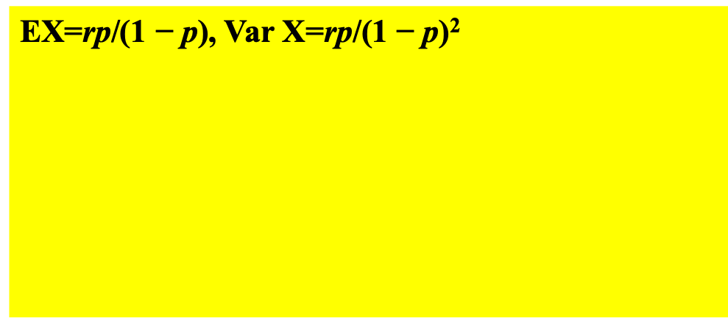
Negative binomial distributions
Nergative binomial distribution (NB)
Zero-inflated negative binomial dist. (ZINB)
Composition of binary distribution and a NB distr.
分成零和非零两种情况，非零时满足负二项分布。
﻿The number of failures in a sequence of i.i.d. Bernoulli trials before a specified (non-random) number of successes r occurs.
扔硬币，出现r次正面前，一共出现了k次背面的概率。
Overdispersed Poisson: mixture of Poisson distributions where the rate is from gamma distribution (next page).
EX=rp/(1 − p), Var X=rp/(1 − p)²
Via Fano factor $\frac{σ^{2}}{μ}$ or the ratio $\frac{σ}{μ}$ depending on the background distribution of interest.
Mainly caused by heterogeneity.
比如负二项分布可以看作泊松混合分布，如果做Poisson回归的时候发现方差过大，就可以考虑负二项分布。

Slide 4
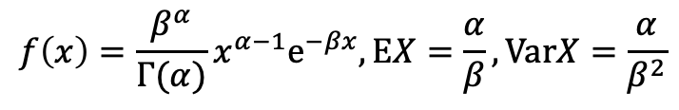
Models
In bacterial gene expression, the copy number of a constitutively expressed protein often follows the gamma distribution, where the scale and shape parameter are, respectively, the mean number of bursts per cell cycle and the mean number of protein molecules produced by a single mRNA during its lifetime.
Characteristics of UMI
其他例子
In oncology, the age distribution of cancer incidence often follows the gamma distribution, whereas the shape and scale parameters (1/beta) predict, respectively, the number of driver events and the time interval between them.
In neuroscience, the gamma distribution is often used to describe the distribution of inter-spike intervals.
In genomics, the gamma distribution was applied in peak calling step (i.e. in recognition of signal) in ChIP-chip and ChIP-seq data analysis.
$$f\left(x\right)=\frac{β^{α}}{Γ(α)}x^{α−1}{\text{e}}^{−βx},\text{E}X=\frac{α}{β},\text{Var}X=\frac{α}{β^{2}}$$
如果alpha是整数，那么alpha个iid的指数分布随机变量加起来就是Gamma分布。这里每个指数分布的期望是1/beta。

Slide 5
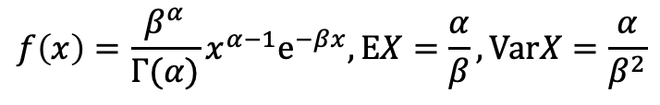
More on Gamma distribution
$$f\left(x\right)=\frac{β^{α}}{Γ(α)}x^{α−1}{\text{e}}^{−βx},\text{E}X=\frac{α}{β},\text{Var}X=\frac{α}{β^{2}}$$
Properties
Origins
A gamma distribution with shape parameter α = 1 and scale parameter θ is an exponential distribution with expected value θ.
A gamma (α, β) random variable with α = ν/2 and β = 1/2, is a chi-squared random variable with ν degrees of freedom.
例子
alpha=mean # of burst per cell cycle
beta=﻿mean # bursts to produce a protein molecule. or the reciprocal of ﻿mean number of protein molecules produced per burst

Slide 6
其他文中未标明的术语
UMI: unique molecular identifier, which counts represents the absolute number of observed transcripts (per gene, cell or sample).
ROGUE: Ratio of Global Unshifted Entropy.

Slide 7
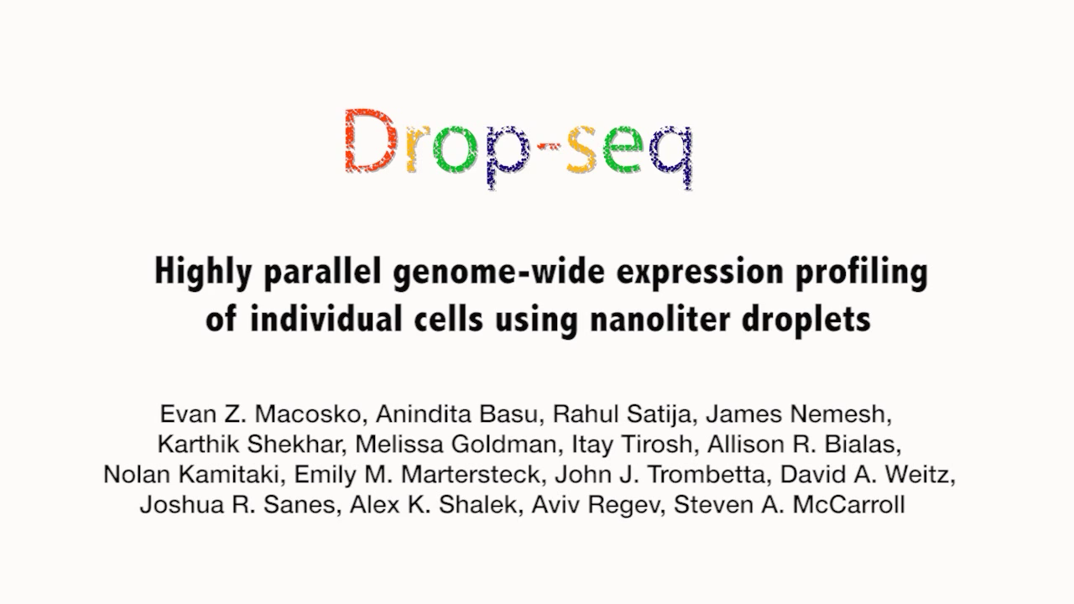

Slide 8
a strong relationship between S and the mean expression level (E) of genes
b. LOESS (locally estimated scatterplot smoothing)
﻿Fig. 1 The expression entropy model. a Identifying pure cell subtypes in unsupervised single-cell data analysis. b The S–E plot of the Tabula Muris (droplet) dataset. Each point represents one gene. The relationship between S and E was fitted with LOESS regression for each gene. c The S–E plot of a T-cell dataset27 obtained by Smart-seq2 protocol. d Accuracy in identifying differentially expressed genes on data simulated from both NB (left) and ZINB (right) distribution, with subpopulation containing 50% of the cells. The center line indicates the median AUC value. The lower and upper hinges represent the 25th and 75th percentiles, respectively, and whiskers denote 1.5 times the interquartile range. Discriminating power of genes selected by S–E model, HVG, Gini, M3Drop, SCTransform, Fano factor, and RaceID3 (“Methods”) estimated by RF with 50 times cross-validation on both droplet-based dataset (e) and full-length-based dataset (f) listed in Supplementary Table 1. The classification accuracy was measured as the percentage of query cells that were assigned the correct label. The center line indicates the median classification accuracy. The lower and upper hinges represent the 25th and 75th percentiles, respectively, and whiskers denote 1.5 times the interquartile range. g Reproducibility of features of brain replicates (Supplementary Table 3). h ARI for the dataset comprising five cell lines6 when different feature selection methods were used.

Slide 9
Comparison of accuracy 人造数据 (Fig. 1d)
Negative binomial
Zero inflated negative binomial
Notes:
The box plots show the accuracy of 𝑆-𝐸 model, Gini, HVG and M3Drop in identifying differentially expressed genes on data simulated form NB distribution, corresponding to Fig. 1d (left). The r denotes the dispersion parameter in NB (Methods) and ‘sub’ represents the fraction of subpopulation. The center line indicates the median AUC value of n=50 repeated runs. The lower and upper hinges represent the 25th and 75th percentiles respectively, and whiskers denote 1.5 times the interquartile range.
The box plots show the accuracy of 𝑆-𝐸 model, Gini, HVG and M3Drop in identifying differentially expressed genes on data simulated form ZINB distribution, corresponding to Fig. 1d (right). The center line indicates the median AUC value of n=50 repeated runs. The lower and upper hinges represent the 25th and 75th percentiles respectively, and whiskers denote 1.5 times the interquartile range.

Slide 10
区分能力的比较

Slide 12
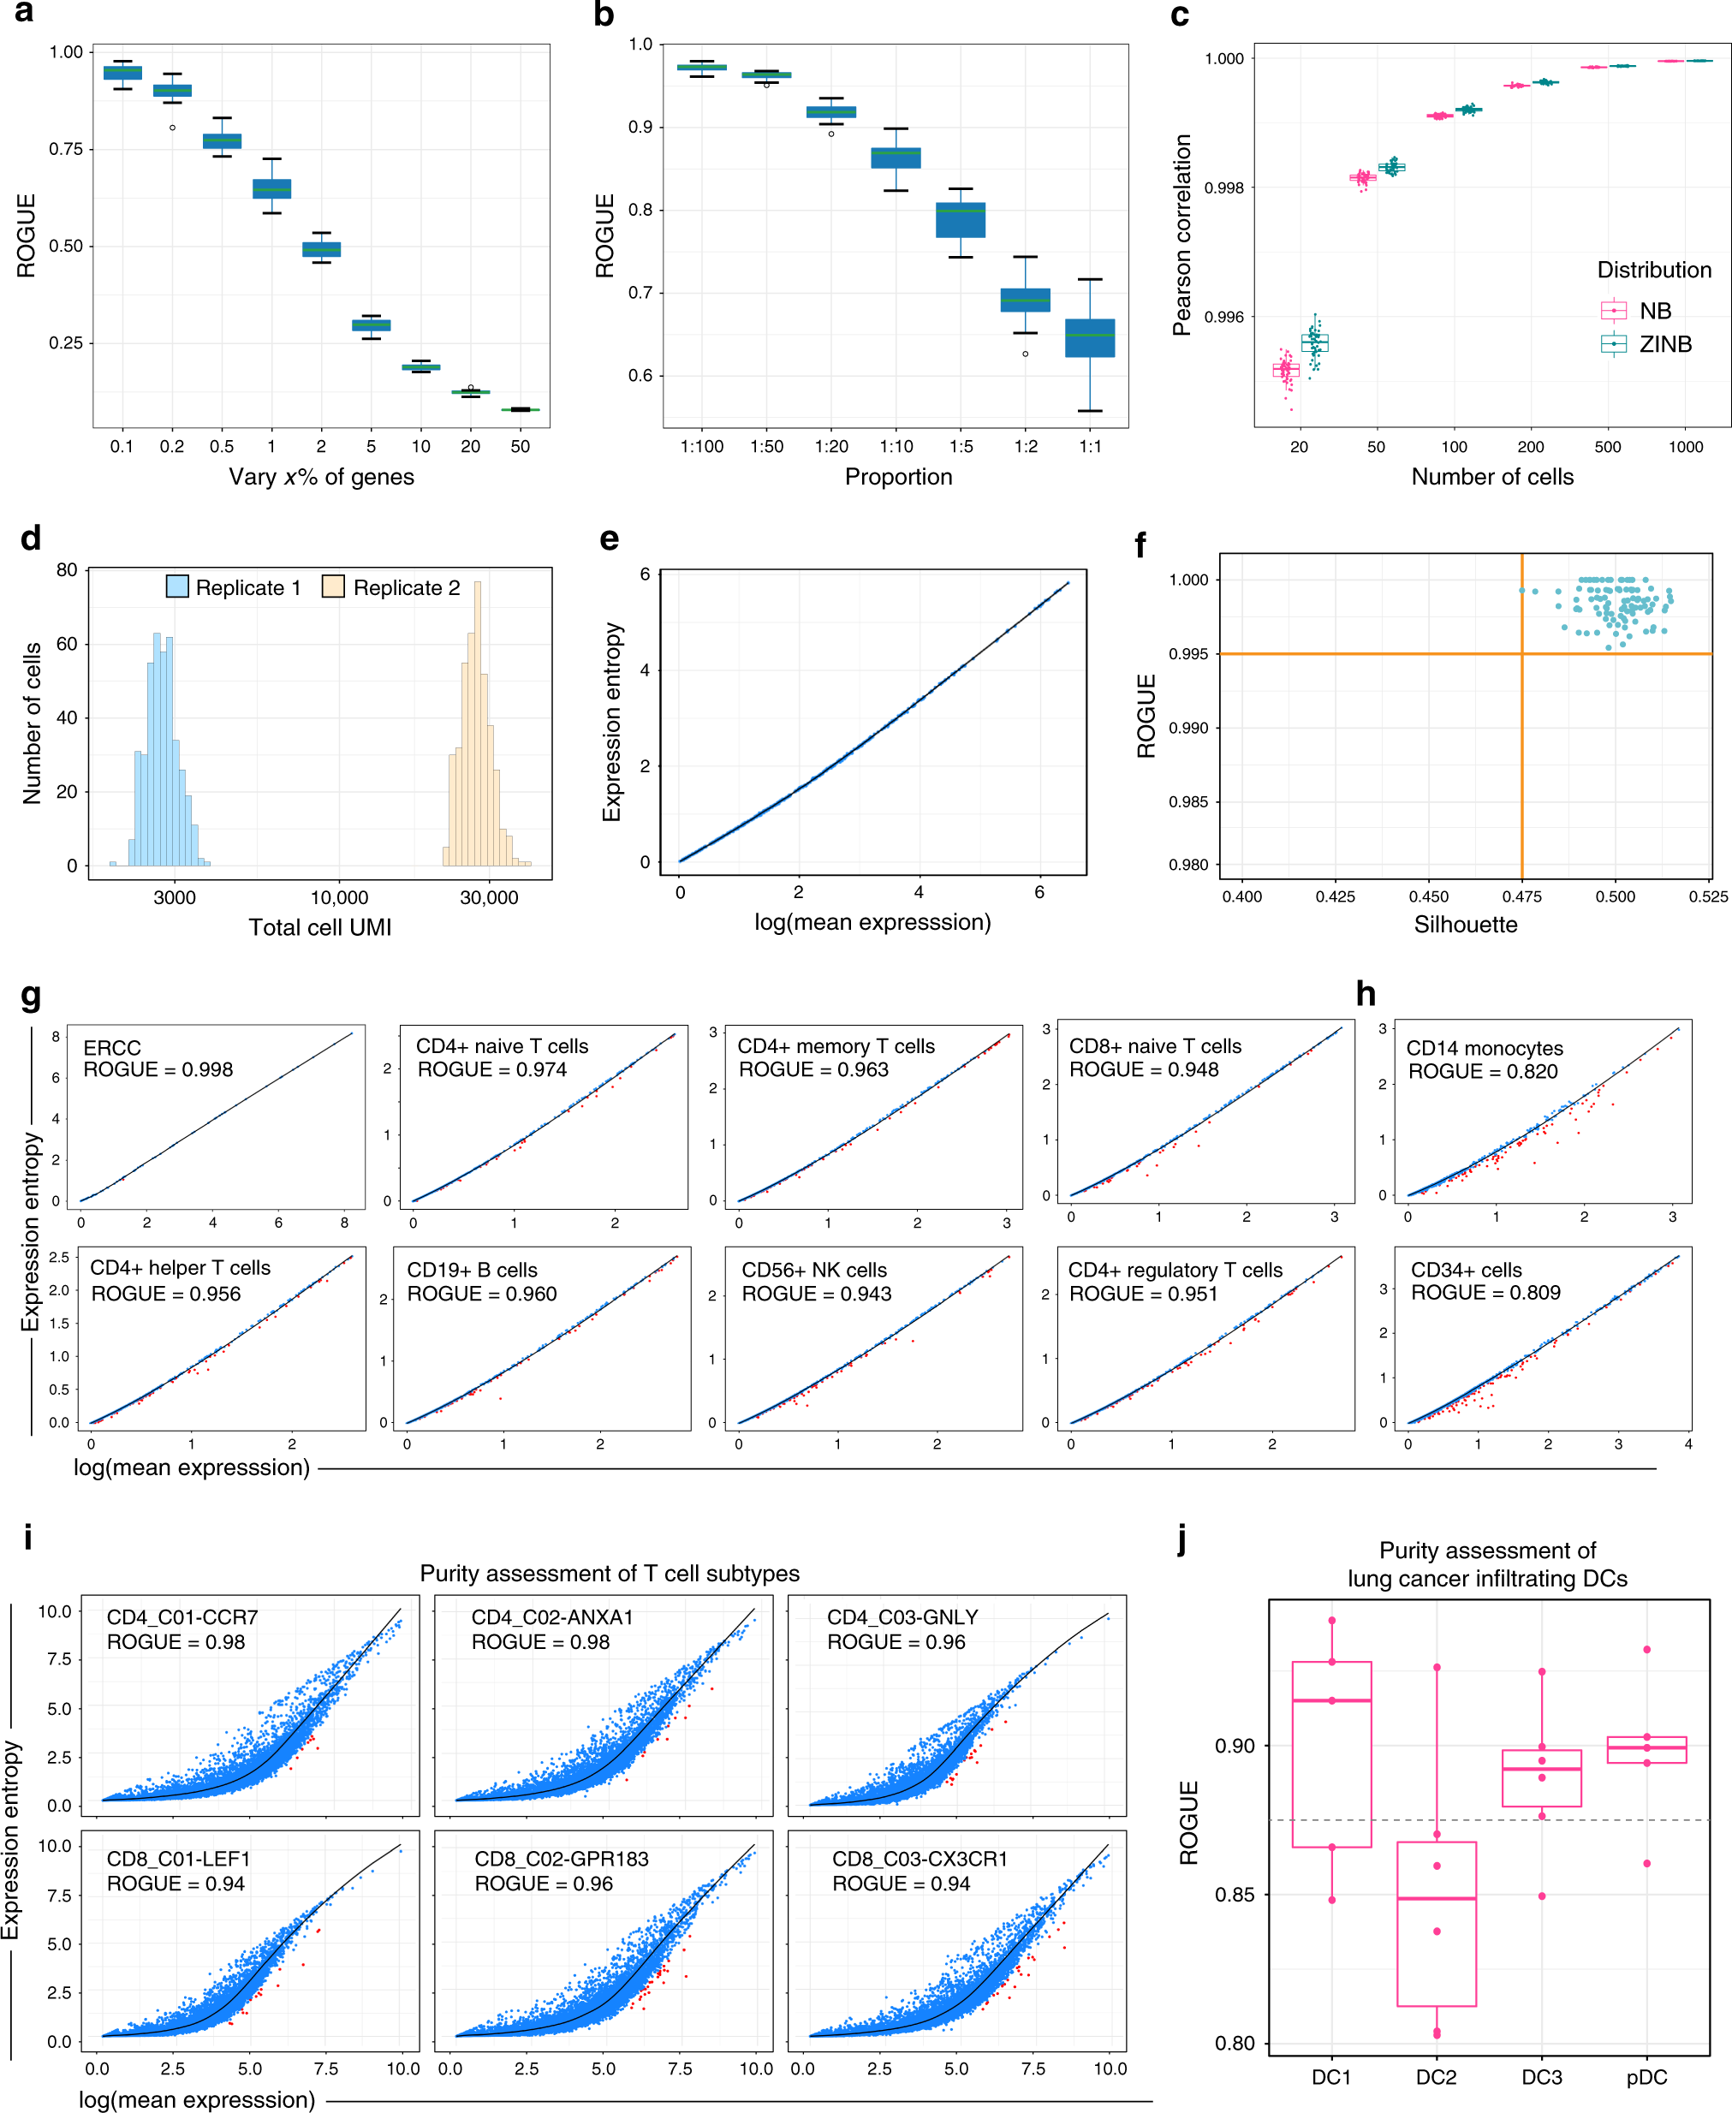
Notes:
﻿Fig. 2 ROGUE use and performance. a The ROGUE index (reference factor K=45) decreases monotonically with increasing varied genes in each simulated mixture consisting of two cell types (1:1). The center line indicates the median ROGUE value of n =50 repeated simulations. The lower and upper hinges represent the 25th and 75th percentiles respectively, and whiskers denote 1.5 times the interquartile range. b The ROGUE values (reference factor K= 45) for the simulated mixtures with cell-type sizes ranging from 1:100 to 1:1. In each mixture, the number of varied genes was 1% of the total gene number (n = 20,000). The center line indicates the median ROUGE value of n =50 repeated simulations. The lower and upper hinges represent the 25th and 75th percentiles respectively, and whiskers denote 1.5 times the interquartile range. c Pearson correlations of S between the randomly down-sampled datasets (n =50 runs for each) and the entire datasets (2000 cells) simulated from both NB and ZINB distribution. The center line indicates the median correlation value. The lower and upper hinges represent the 25th and 75th percentiles respectively, and whiskers denote 1.5 times the interquartile range. d Sequencing depth distribution (total UMI counts across cells) for two simulated replicates. The replicate 2 has a sequencing depth ten times that of replicate 1. e The S–E plot of the mixture of replicates 1 and 2 is shown in d. f ROGUE values of n = 100 mixtures versus the silhouette values for every two replicates within individual mixtures. A high silhouette value indicates a substantial difference in sequencing depth between two replicates. g, h The S–E plots and corresponding ROGUE values of 10 cell populations from the PBMC dataset24. i Purity assessment of six human T-cell populations. j Purity evaluation of lung-cancer infiltrating DCs, with each point representing a patient. The center line indicates the median ROUGE value. The lower and upper hinges represent the 25th and 75th percentiles, respectively, and whiskers denote 1.5 times the interquartile range.

Slide 14
Robustness

Slide 15
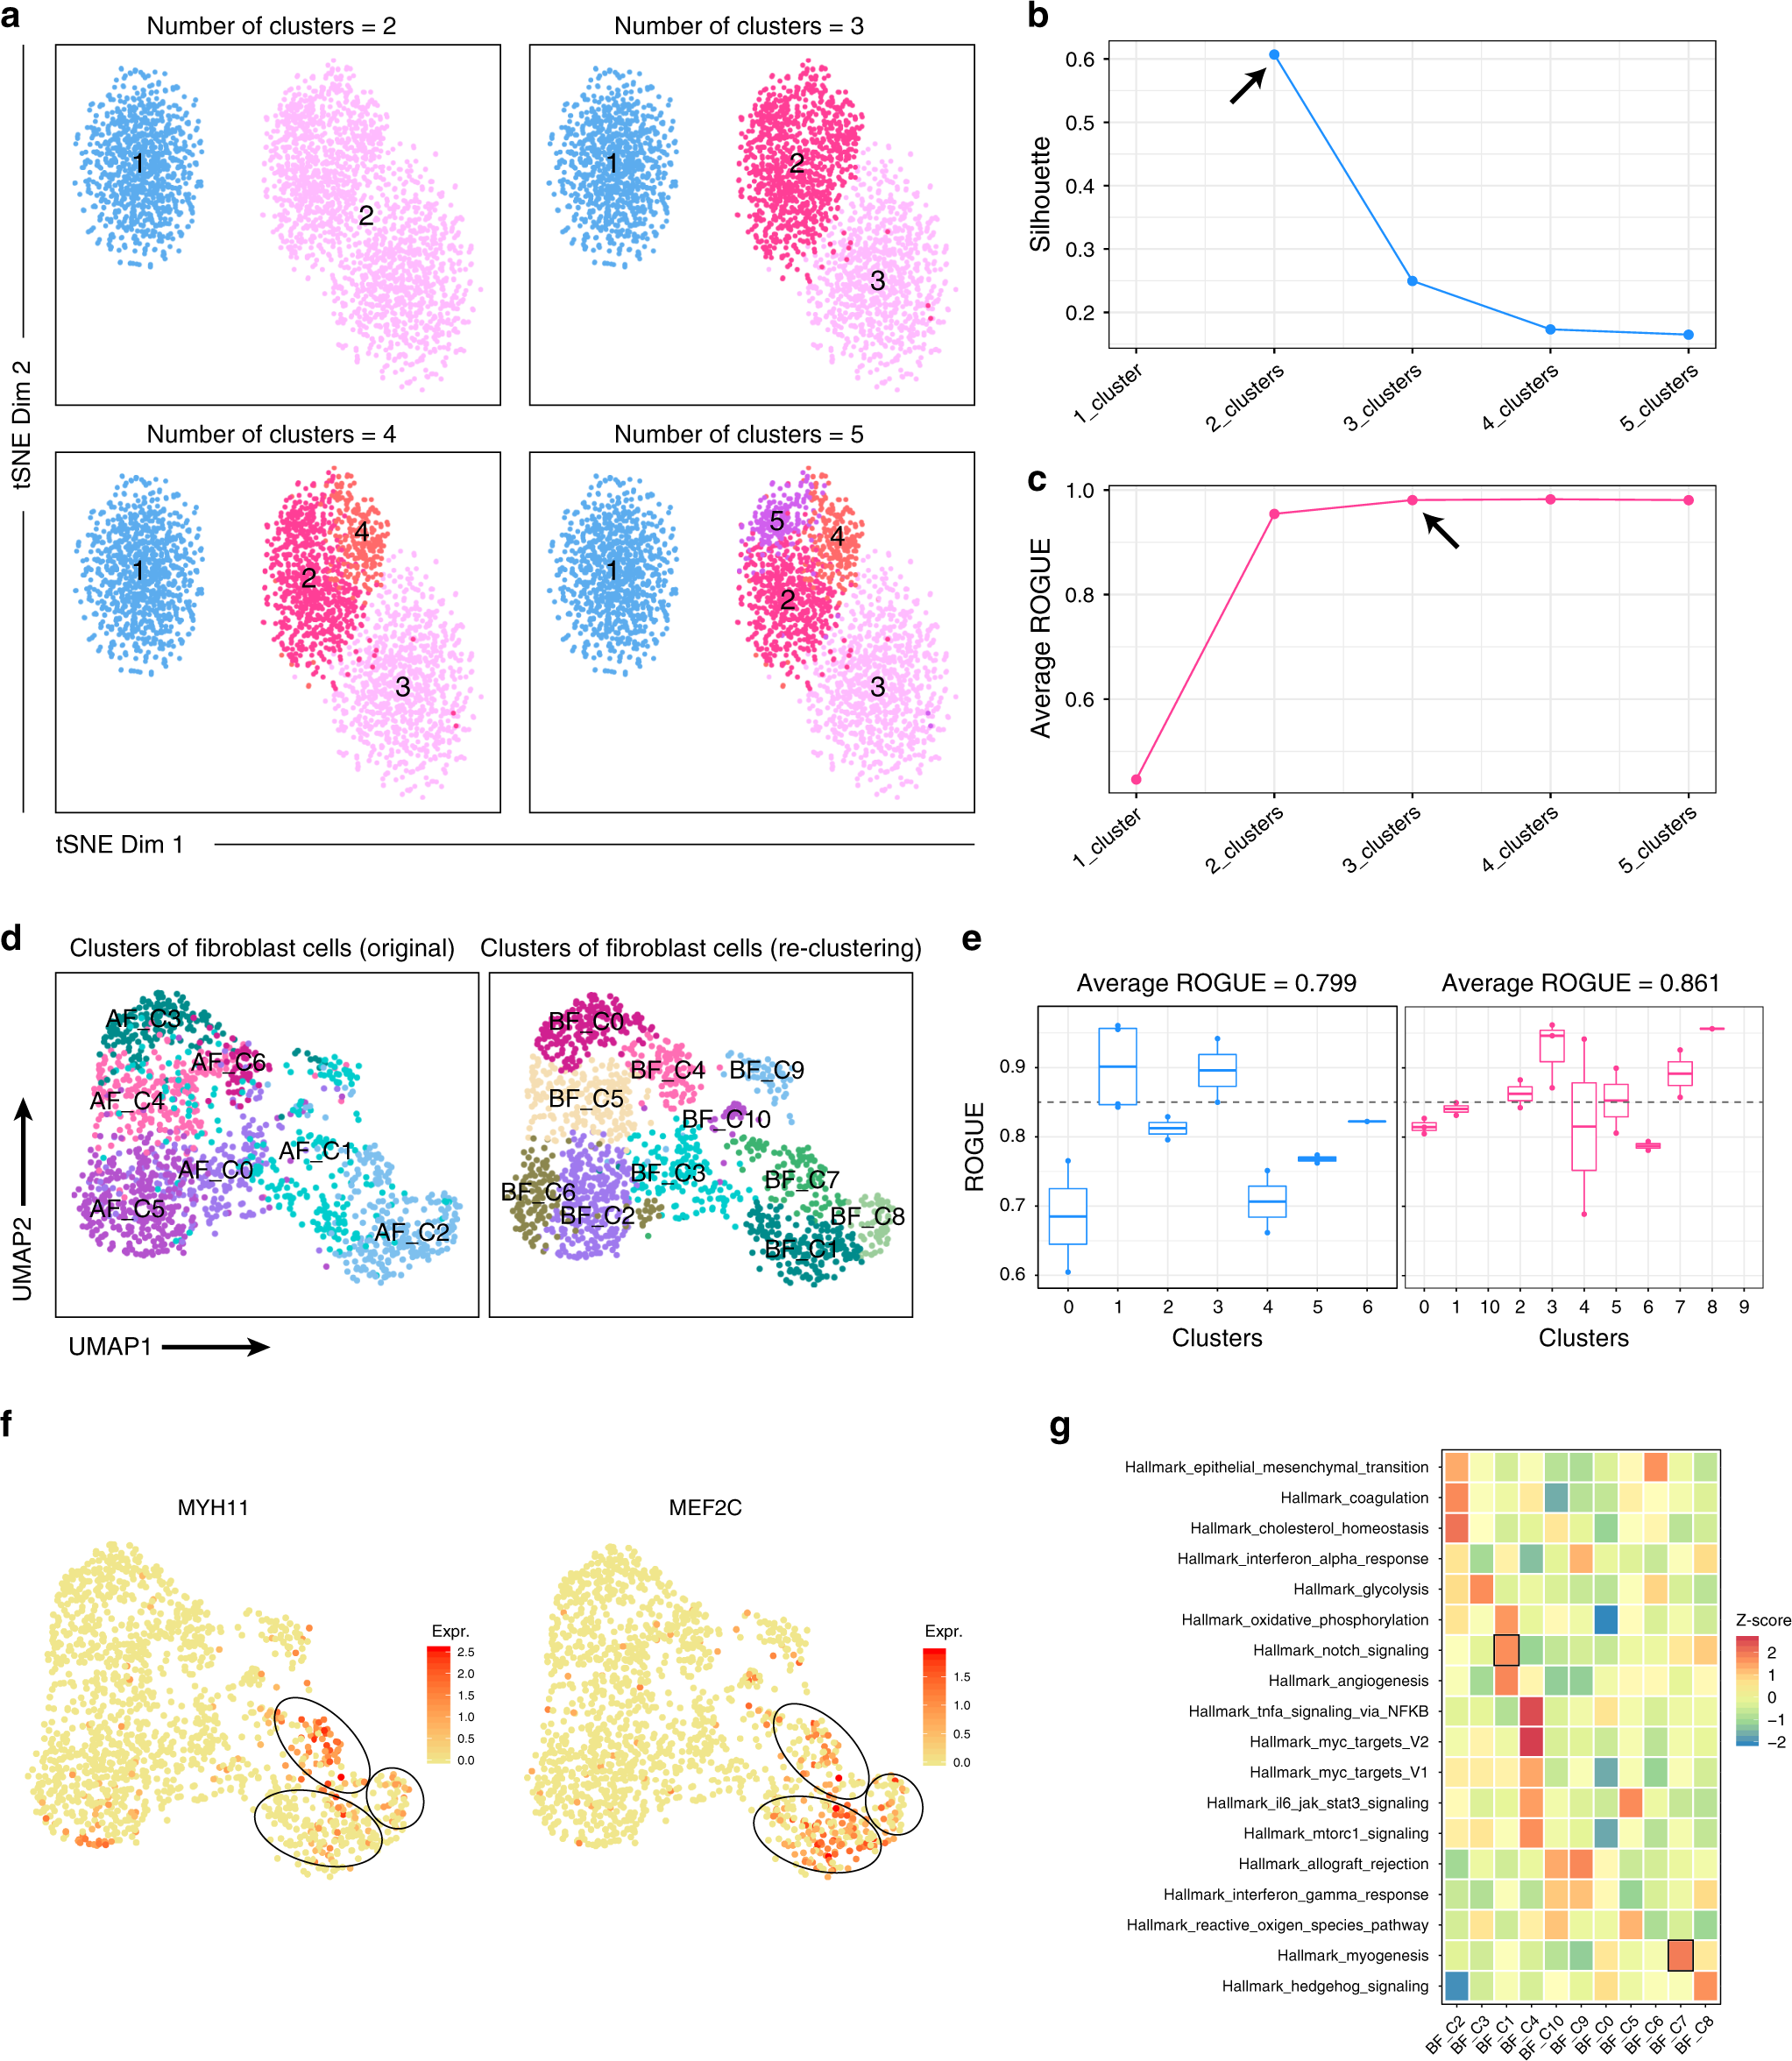
Simulated datasets
Notes:
Fig. 3 ROGUE enhances single-cell clustering and cell-type identification. a t-SNE plots of a simulated dataset containing three cell types. Corresponding silhouette values (b) and average ROGUE values (c) when there were 2, 3, 4, and 5 putative clusters, respectively. d UMAP plots of lung-cancer-associated fibroblasts, color-coded by clusters in original paper (left; Supplementary Fig. 17a) and re-clustered labels (right). e ROGUE values of different clusters before (left) and after (right) re-clustering. Each point represents a patient. The center line indicates the median ROUGE value. The lower and upper hinges represent the 25th and 75th percentiles respectively, and whiskers denote 1.5 times the interquartile range. f UMAP plot of expression levels of MYH11 and MEF2C. g Differences in hallmark pathway activities scored using GSVA.

Slide 16
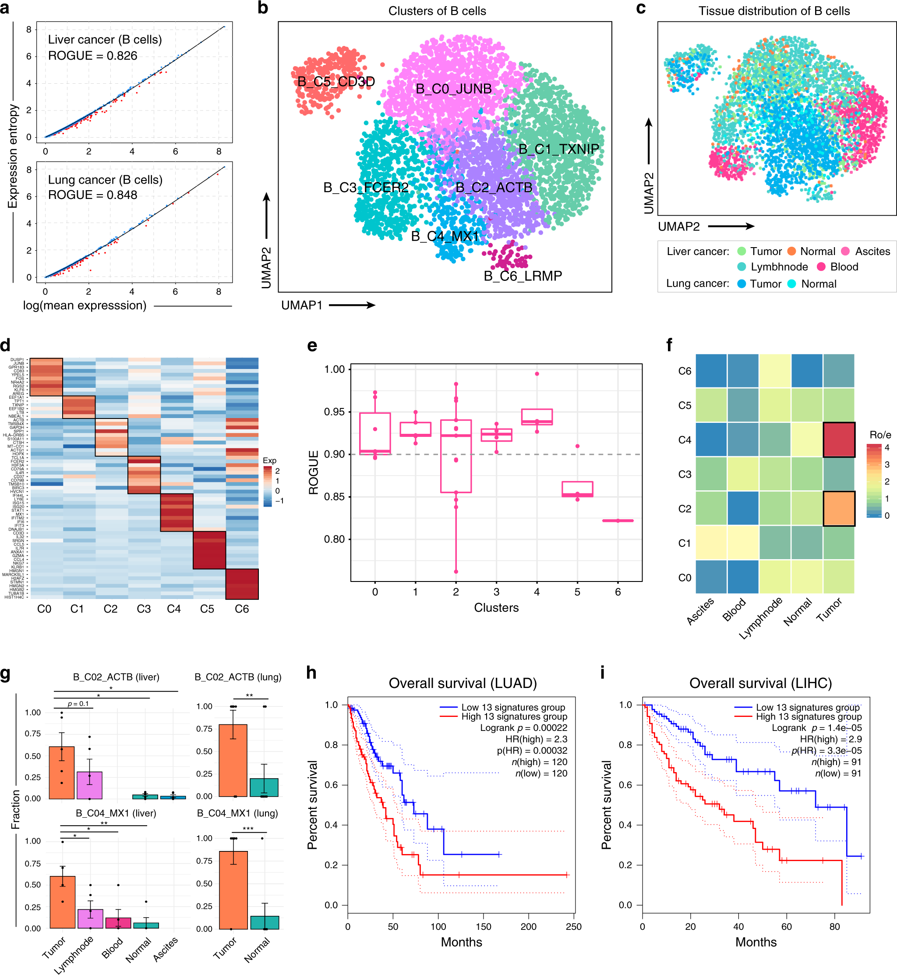
用在浸润的B细胞数据上
Notes:
﻿Fig. 4 ROGUE-guided analysis in the identification of pure B-cell subtypes. a The S–E plots and ROGUE values of liver- and lung-tumor-infiltrating B cells, respectively. UMAP plots of 4291 B cells, color-coded by their associated clusters (b) and tissues (c). d Gene expression heatmap of seven B-cell clusters. Rows denote marker genes and columns denote different clusters. e ROGUE values of seven identified B-cell subtypes. Each point represents a patient. The center line indicates the median ROUGE value. The lower and upper hinges represent the 25th and 75th percentiles, respectively, and whiskers denote 1.5 times the interquartile range. f Tissue preference of each B-cell subtype in liver cancer estimated by RO/E27, the ratio of observed to expected cell numbers calculated by the chi-square test. g The average fractions of B_C02_ACTB and B_C04_MX1 in each patient across tissues, where error bars representing ±s.e.m. *p < 0.05, **p < 0.005, Student’s t test. The Kaplan–Meier curves of TCGA LUAD (h) and LIHC (i) patients grouped by the 13 markers (Supplementary Table 5) of B_C02_ACTB.

Slide 17
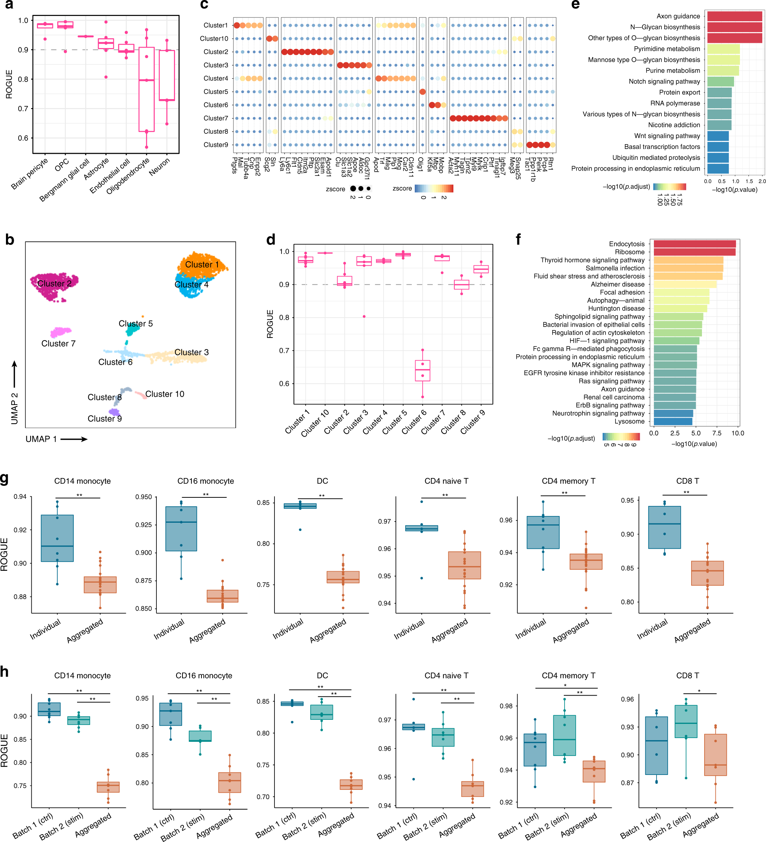
用在脑数据上

Slide 18
Datasets

Slide 19
Take-home messages
作者做了什么
我们学到了什么
作者以熵为基础给出了评价细胞纯度的一个公式。
作者用这个公式给出了细胞亚型分类的新方法。
这个方法可以识别1%以下的细胞，并且具有很好的鲁棒性。
作者用他的这个方法重新研究了一些公开数据集，细分了细胞亚型。
文中的高质量单细胞数据集。
单细胞数据的产生及其统计特征。
对于一个新算法进行分析时需要考虑的因素及其展示方式。

